Slide 1


M.Tech Program
Advanced Industry Integrated Programs
AI-Powered Healthcare System for Diabetes Risk Prediction
and Lifestyle Management
Team Member
NIVYASREE.C
M.Tech CSE(Artificial Intelligence and Machine Learning)(VIT VELLORE)
Knowledge partner | Implementation partner

Slide 2
AI-Powered Healthcare System for Diabetes Risk Prediction and lifestyle Management
and Lifestyle Management
dy 18
Introduction
AI-based app for diabetes risk prediction and lifestyle guidance
Inputs: clinical data + meal logs via text
Uses Random Forest for risk classification and BERT for nutrition analysis
Built with Streamlit, secured via Azure AD
Dockerized for scalable deployment on Azure Cloud

Slide 3
AI-Powered Healthcare System for Diabetes Risk Prediction and lifestyle Management
Objective
Predict diabetes risk using clinical and dietary data.
Analyze meals using NLP for calorie/sugar estimation.
Classify users into risk levels using ML.
Provide personalized lifestyle recommendations.
Build a secure, user-friendly system.

Slide 4
AI-Powered Healthcare System for Diabetes Risk Prediction and lifestyle Management
Scope
Collect clinical and meal data.
Use BERT and Random forest for analysis and prediction.
Generate lifestyle suggestions based on risk.
Implement Azure AD authentication.
Deploy using Docker on Azure.
.

Slide 5
AI-Powered Healthcare System for Diabetes Risk Prediction and lifestyle Management System
Literature Review
[1] M. Chidambaram, M. Narayanan, C. Sankar, and J. Santhosh, “An Ensemble Learning and Machine Learning Approach for Predicting Diabetic Disease,” Published, 2024.
[2] V. V. N. S. B. Rohith, S. K. Rudroju, S. C. Kamisetty, and P. Balamurugan, “Personalized Diabetes Suggestion Using ML Algorithms and Cloud Technology,” International Journal of Scientific Research and Management (IJSRM), 2024.

Slide 6
AI-Powered Healthcare System for Diabetes Risk Prediction and lifestyle Management
Literature Review
[3] M.Patil, M. S. Shaikh, and Prashant Singh, “Web-Based Diabetes Prediction System Using Machine Learning,” in 2022 International Conference on Advances in Computing, Communication and Applied Informatics (ACCAI), IEEE, 2022.
[4] Shanmugpriya.T.K, S. Karunambikai .R, “Diabetes Prediction and Classification using Machine Learning and Deep Learning: A Chatbot-Based Approach,” in 2025 International Conference on Intelligent Systems and Computer Vision (ISCV), IEEE, 2025

Slide 7
Summary of literature
XGBoost algorithms used for large dataset;lacks lifestyle integration.
LSTM model with good accuracy;desktop-only chatbot.
RF achieved good accuracy; simple Flask app, no personalization.
ML and DL-based system for diabetes classification using chatbot interface
Cloud-based nutrition advice; low model accuracy (52.86%)

Slide 8
Research Gap
1. An Ensemble Learning and Machine Learning Approach for Predicting Diabetic Disease
Focused on algorithm benchmarking only, no deployment, no lifestyle/nutrition personalization.
2. Diabetes Prediction and Classification Using Machine Learning and Deep Learning: A Chatbot-Based Approach
Desktop-only, local database (SQLite), no cloud scalability, no nutrition integration, no real-world deploymen

Slide 9
Project Title - Calibri body 18
Research Gap
3.Diabetes Predicting mHealth Web-Based Applications
Most lacked personalization, nutrition/lifestyle integration, explainability, and secure cloud deployment.
4. Diabetes Predicting mHealth Application Using Machine Learning
Very low accuracy, limited features, no nutrition or advanced ML integration, not scalable

Slide 10
Modular to Cover
MODULAR | WEEKS | TASK
Module 1 | WEEK1 | Data Acquisition & Preprocessing
Module 2 | WEEK2 | Train Machine Learning Models
Module 3 | WEEK3 | Advanced Models & NLP
Module 4: | WEEK4 | Risk Prediction & Stratification
Module 5 | WEEK5 | Recommendation Engine
Module 6 | WEEK6 | Deployment
Module 7 | WEEK7 | Testing & Validation
Module 8 | WEEK8 | Monitoring & Maintenance

Slide 11
Module Name and Coverage
User Authentication Module
Azure AD integration
Secure login and session management
Clinical Data Input Module
Form for entering glucose, BMI, blood pressure, age, family history
Validation and preprocessing of inputs
Meal Logging Module
Text-based drop box for food entries
NLP processing using BERT-based regression
Calorie and sugar estimation using Indian Nutrition Dataset

Slide 12
Project Title - Calibri body 18
Module Name and Coverage
Risk Prediction Module
ML model (e.g.RandomForest) for diabetes risk classification
Uses clinical + nutritional data
Lifestyle Recommendation Module
Personalized suggestions based on risk level
Includes diet, exercise, and follow-up advice
Frontend UI Module
Built with Streamlit
Interactive dashboards and input forms

Slide 13
Project Title - Calibri body 18
MODULE NAME AND COVERAGE
Deployment & Scaling Module
Azure Cloud deployment
Docker orchestration and scalability setup

Slide 14
Initial Data Source and Identification
PIMA Indian Diabetes Dataset
Contains clinical data like glucose, BMI, age, blood pressure
Used for training the diabetes risk prediction model
Indian Nutrition Dataset
Includes food items with calorie and sugar values
Used for meal analysis via text input and nutritional estimation

Slide 15
Identification
Clinical Data – entered by the user via form fields:
Glucose level, BMI, blood pressure, age, family history.
Meal Data – entered as free text in a drop box:
Identification Process
Clinical Data: Directly mapped to structured features for the ML model.
Meal Data: Processed by a BERT model to identify food items and estimate:
Calories
Sugar content
These features are combined and used for risk classification and recommendation generation.

Slide 16
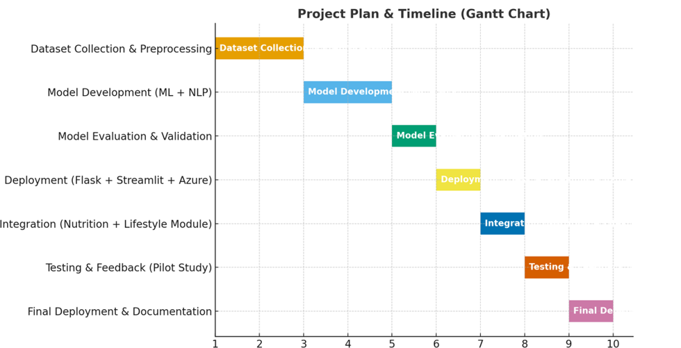
Project plan & Timeline

